Slide 1

C# Advanced – Class13
Trainer/Assistant: Martin Panovski – panovski.martin93@gmail.com
Trainer/Assistent: Dejan Jovanov – djovanov92@gmail.com
Code academy @ Skopje, 2019

Slide 2
Agenda
Synchronous vs. Asynchronous Programming
Threads and Multi Threading
Tasks and Async/Await
Difference Between Task and Thread

Slide 3
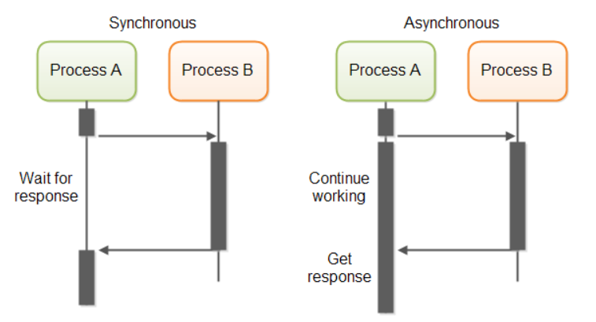
Synchronous vs. Asynchronous Programming

Slide 4
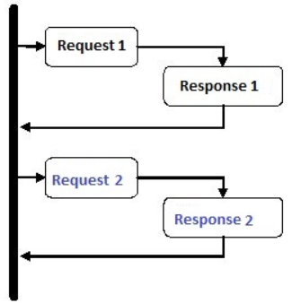
Synchronous vs. Asynchronous Programming
Synchronous approach
Application program is executed line by line, one line at a time.
In case of method call, program execution has to wait until the method is completed.

Slide 5
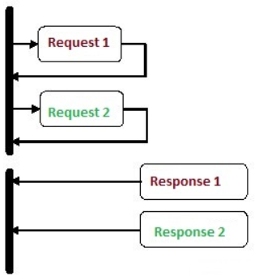
Synchronous vs. Asynchronous Programming
Asynchronous approach
Application program is executed line by line.
In case of method call, program execution continues to the next line, without waiting for the method to complete.

Slide 6
Synchronous vs. Asynchronous Programming
Pseudo code overview
Synchronous model
Asynchronous model
line 1: .....
line 2: .....
line 3: TimeConsumingMethod() [10 secs]
line 4: .....
line 5: .....
............
line 1: .....
line 2: .....
line 3: TimeConsumingMethod(callback) [10 secs]
line 4: .....
line 5: .....
callback()
{
}

Slide 7
Synchronous vs. Asynchronous Programming
Why Asynchronous over Synchronous..?
Asynchronous Programming improves responsiveness.
When..?
Any time we identify a blocking operation.
Commonly used scenarios
Your opinion for real life model…? ☺

Slide 8
Synchronous vs. Asynchronous Programming
Practical implementation
Event – based design scenarios
Working with different file types and databases
Loading and operating with images and videos
Accessing the Web
Real life examples
Downloading Visual Studio installer
Listening music on Youtube
Social medias

Slide 9
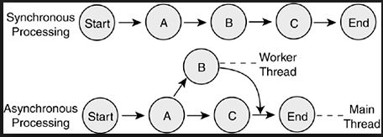
Synchronous vs. Asynchronous Programming
Processing data application example

Slide 10
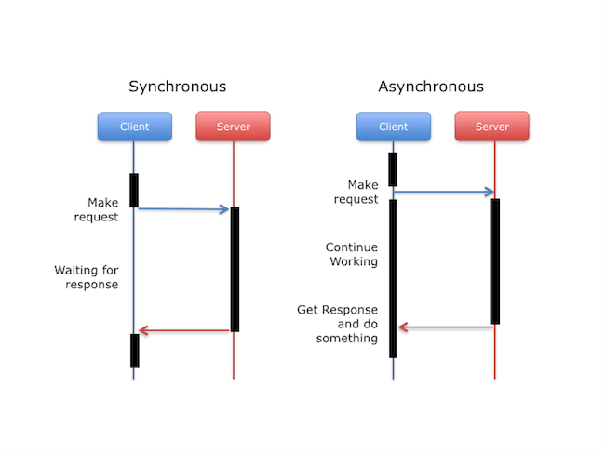
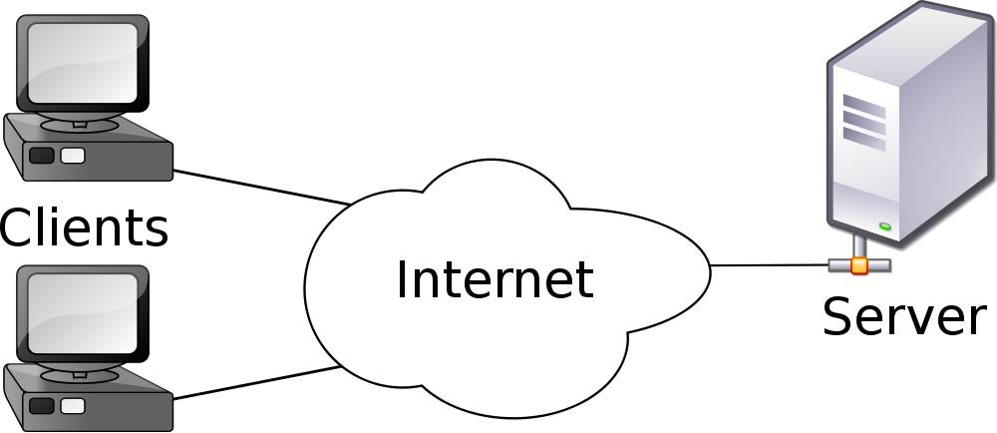
Synchronous vs. Asynchronous Programming
Client – Server architecture

Slide 11
Synchronous vs. Asynchronous Programming
Asynchronous Programming Models
Traditional approach
Multi - threading
Task – based asynchronous approach (.NET 4.5)
Async/Await (introduced in C# 5)

Slide 12
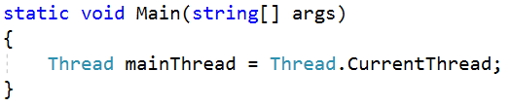
Threads and Multi Threading
An application consists of one or more processes.
A process is an executing program.
What is a Thread?
A thread is the basic unit to which the operating system allocates processor time.
A thread is defined as the execution path of a program.
using System.Threading;

Slide 13
Threads and Multi Threading
Single - threaded vs. Multi - threaded program
Single - threaded
Can be understand as one thread with full access to the process.
Multi - threaded
In one process can live and coexists multiple threads.
Threads are executed independently, but can share same resources within the process.

Slide 14
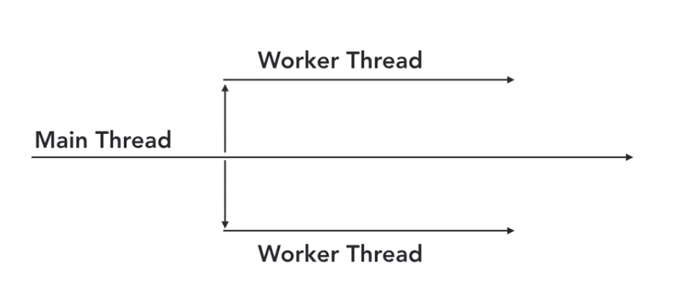
Threads and Multi Threading
Multiple Threads = Threading
Threading refers to Multiple Threading

Slide 15
Threads and Multi Threading
CPU
Thread 1
Thread 1
CPU Core 1
Thread 2
Thread 2
CPU Core 2
Thread 3
CPU Core 3
Thread 3
Multiple threads -> one CPU unit
Multiple threads -> multiple CPU units/cores

Slide 16
Threads and Multi Threading
We cannot guarantee when a thread will be executed.
Well known race condition scenario in threading.
Threading execution is unpredictable.
Complex concepts as Lock and Join needed in order to keep data consistency.

Slide 17
Demo
Hands on activities… ☺

Slide 18
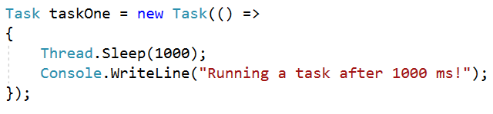
Tasks and Async/Await
Task basically represents an asynchronous operation.
What is a Task?
A task is an object that represents some work that should be done.
We are aware of the task completion and returned result.
using System.Threading.Tasks;

Slide 19
Demo
Hands on activities… ☺

Slide 20
Tasks and Async/Await
Why Tasks?
The goal is to enable code that reads like a sequence of statements, but executes in a much more complicated order based on external resource allocation and when tasks complete.
Instead of creating your own thread, unless you really need to do it, make use of a Thread Pool.
Thread pooling is the process of creating a collection of threads during the initialization of a multithreaded application, and then reusing those threads for new tasks as and when required, instead of creating new threads.

Slide 21
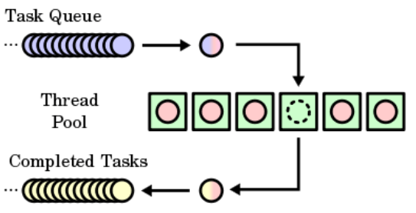
Tasks and Async/Await
Thread Pool

Slide 22
Tasks and Async/Await
async and await keywords for calling functions in an asynchronous way.
async and await as code markers, which marks code positions from where the control should resume after a task completes.
The await operator is applied to a task in an asynchronous method to insert a suspension point in the execution of the method until the awaited task completes.
Golden rule:
await can only be used in an asynchronous method modified by the async keyword.

Slide 23
Difference Between Task and Thread
You can accomplish the same with a thread as you can with a task.
Task uses a thread in order to execute asynchronous.
Task can be seen as a convenient and easy way to execute something asynchronously and in parallel.
Task as a higher level abstraction upon threads.
A Task is a higher level concept than Thread.
The task can return a result. There is no direct mechanism to return the result from a thread.

Slide 24
Demo
Hands on activities… ☺

